Slide 1



Kingdom of Saudi Arabia
Ministry of Education
Majmaah university
‏College of science Al Zulfi
Dept. Computer & information
المملكة العربية السعودية
وزارة التعليم
جامعة المجمعة
كلية العلوم بالزلفي
قسم علوم الحاسب والمعلومات
RESEARCH ABOUT
EARLY DETECTION OF CYBER ​ATTACKS ON E-BUSINESS
PLATFORMS USING ARTIFICIAL INTELLIGENCE
‏الاكتشاف المبكر للهجمات السيبرانية على منصات الأعمال الإلكترونية باستخدام الذكاء الاصطناعي
Presented by:
Jana Altayyar Raya Alhumaidi Sarah Alotaibi
2024-2025
Supervised by: Maria Altaib Badawi

Slide 2
INTRODUCTION
E–business platforms are undergoing a fundamental transformation driven by rapid digital evolution, providing unprecedented efficiency and flexibility. However, this shift is accompanied by escalating cybersecurity risks, exposing vast amounts of sensitive data and making these platforms attractive targets for cybercriminals.
Among the most serious and dangerous cyberattacks is the SQL Injection attack, which often targets databases in order to manipulate or extract sensitive information. With the continuous advancement of fraud techniques, early detection of malicious activities is crucial for safeguarding these platforms. The Kingdom of Saudi Arabia has achieved global recognition in cybersecurity, reflecting its commitment to Vision 2030 goals.
Nonetheless, the increasing complexity of cyber threats necessitates continuous improvement in security measures to ensure a secure future for e-business

Slide 3
Goals:
01
02
03
Enhancing Cybersecurity for E-business Transactions.
Early Detection of Fraud and Risk Reduction.
Utilizing AI and Machine Learning for Building a Secure Transaction Environment

Slide 4

Tools
Python was selected as the primary tool for this project due to its versatility and robustness.
advantages of python:
1
Cross-Platform Compatibility: Runs on various operating systems (Windows, Mac, Linux, Raspberry Pi, etc.).
2
Concise Syntax: Allows for writing programs with fewer lines of code.
3
Multi-Paradigm Support: Supports procedural, object-oriented, and functional programming.

Slide 5
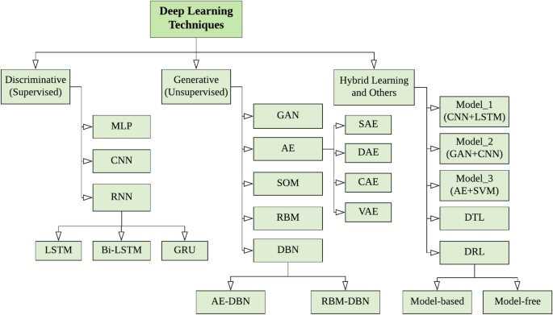
Deep Learning ALGORITHMS:

Slide 6
Deep Learning (CNN Algorithm)
Definition:
A specialized neural network model designed for processing grid-like data, such as images.
Function:
Utilizes convolutional layers to automatically detect and learn spatial hierarchies of features in the input data.
Benefits:
Achieves high accuracy in image classification and object detection tasks. Reduces the need for manual feature extraction, allowing for end-to-end training.

Slide 7
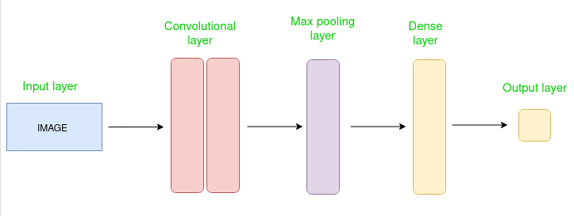
Deep Learning (CNN Algorithm)

Slide 8
Deep Learning (BiLSTM Algorithm)
Definition:
A neural network model used for sequential data processing.
Function:
Learns representations from data in both forward and backward directions.
Benefits:
Enhances prediction accuracy by leveraging contextual information from both past and future. Highly effective in tasks such as machine translation and sentiment analysis.

Slide 9
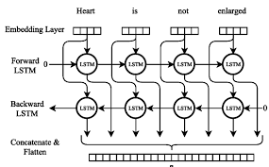
Deep Learning (BiLSTM Algorithm)

Slide 10
CNN-BiLSTM Algorithm:
Definition:
A hybrid model that combines CNNs for feature extraction with BiLSTM for sequence modeling.
Function:
Uses convolutional layers to capture spatial features from input data, followed by BiLSTM layers to learn temporal dependencies in both directions.
Benefits:
Enhances performance in tasks involving sequential data with spatial characteristics, such as video analysis and text classification. Leverages the strengths of both CNNs and BiLSTMs for improved prediction accuracy.

Slide 11
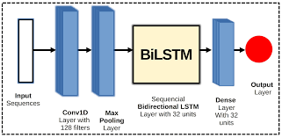
CNN-BiLSTM Algorithm: Optimal SQLIA Detection

Slide 12

Dataset
Dataset is a collection of organized data, typically arranged in tables, arrays, or specific formats such as CSV or JSON, which facilitates data retrieval and analysis. Datasets are essential for data analysis, machine learning (ML), artificial intelligence (AI), and other applications that require reliable and accessible data.
Source
Size
Columns
Compiled from multiple Kaggle datasets, focusing on SQL injection data.
Training: 98,062 records
Testing: 32,696 records
Validation: 32,695 records
Query: SQL query string
Label: Indicates SQL injection presence
(1 = injection, 0 = benign)

Slide 13
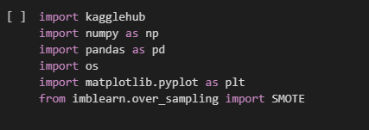
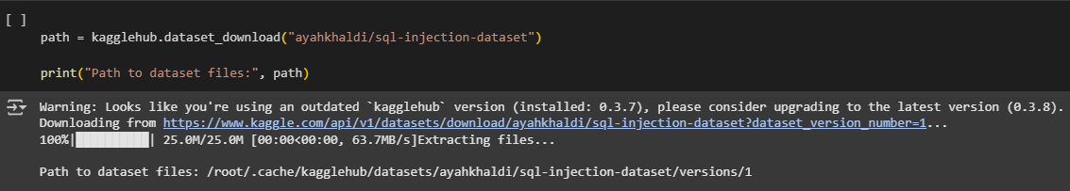
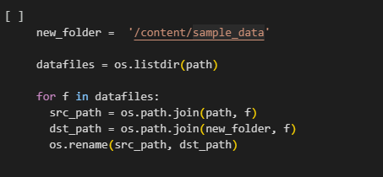
Dataset
Step 1: Library Import
Step 2: Dataset Download
Step 3: Path Simplification

Slide 14
Preprocessing
01
Handle Missing Values: Removed NULL entries.
02
Analyze Class Balance: Checked positive/negative case distribution.
03
Consolidate Data: Merged training and testing sets.
04
Text Preprocessing: Using Tokenization, Lowercasing and Padding.
05
Data Reshaping: Adjusted data dimensions for model input.
06
Prepare Labels: Converted labels to NumPy arrays.
07
Split Data: Split data into 90% training and 10% testing using train_test_split.

Slide 15
1. CNN Model
As part of this project, we implemented the CNN model to detect SQL injection attacks targeting e-business platforms. The model’s performance will be compared to that of the CNN-BiLSTM model to identify which achieves superior accuracy in early-stage attack detection

Slide 16
CNN Model Architecture
Conv1D Layer
MaxPooling1D
Flatten Layer
Dense Layer
Embedding layer
Dropout Layer
Final Dense Layer
Spatial Dropout Layer

Slide 17
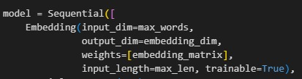

1 . | Embedding Layer
 | Converts input words to dense vectors (output_dim). Utilizes a pre-trained embedding_matrix as initial weights.
2 . | Spatial Dropout Layer
 | Applies spatial dropout with a rate of 0.2 (20%) to the embedding dimensions. Helps prevent overfitting by randomly dropping entire feature maps (embedding dimensions for all words at a specific position).

Slide 18
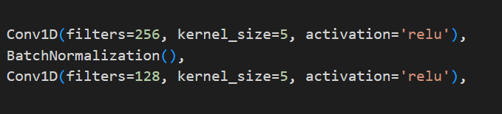

3. | Convolutional And Batch Normalization Layers (Conv1D)
 | First Conv1D: Employs 256 filters with a kernel_size of 5 and relu activation. Extracts local features from the sequence of embeddings. Batch Normalization (BatchNormalization): Follows the first Conv1D layer to improve training stability and speed. Second Conv1D: Uses 128 filters with a kernel_size of 5 and relu activation. Learns more abstract features based on the output of the previous convolutional layer.
4. | Max Pooling Layer
 | Reduces the sequence length by a factor of pool_size=2. Retains the most salient information within each pooling window.

Slide 19


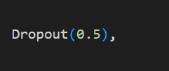

5. | Flatten Layer
 | Transforms the 3D output of the Bidirectional LSTM into a 2D tensor, preparing it for the fully connected layers..
6. | Dense Layer
 | A fully connected layer with 128 units and relu activation. Learns complex relationships between the flattened features.
7. | Dropout Layer
 | Applies dropout with a rate of 0.5 (50%) to the units in the preceding Dense layer to prevent overfitting.
8. | Final Dense Layer (Dense)
 | The output layer with 1 unit and sigmoid activation. Suitable for binary classification tasks, outputting a probability between 0 and 1.

Slide 20
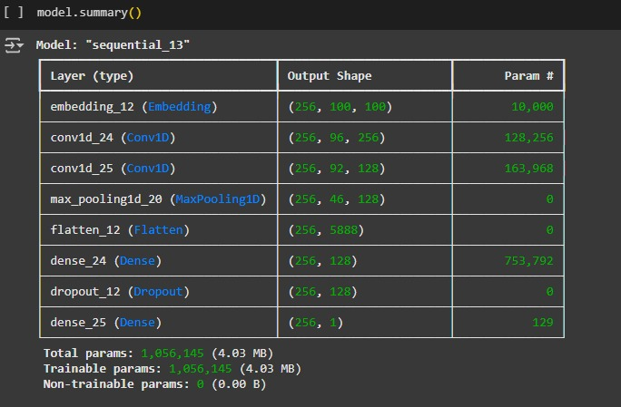
Model Architecture Summary

Slide 21
2. CNN-BiLSTM Model

Slide 22
CNN-BiLSTM Model Layers
1. Embedding Layer
2. Spatial Dropout Layer
3. Convolutional Layers
4. Max Pooling Layer
5. Bidirectional LSTM Layer
6. Flatten Layer
7. Dense Layer
8. Dropout Layer
9. Final Dense Layer

Slide 23
1 . | Embedding Layer
 | Converts input words to dense vectors (output_dim). Utilizes a pre-trained embedding_matrix as initial weights.
2 . | Spatial Dropout Layer
 | Applies spatial dropout with a rate of 0.2 (20%) to the embedding dimensions. Helps prevent overfitting by randomly dropping entire feature maps (embedding dimensions for all words at a specific position).

Slide 24
3. | Convolutional And Batch Normalization Layers (Conv1D)
 | First Conv1D: Employs 256 filters with a kernel_size of 5 and relu activation. Extracts local features from the sequence of embeddings. Batch Normalization (BatchNormalization): Follows the first Conv1D layer to improve training stability and speed. Second Conv1D: Uses 128 filters with a kernel_size of 5 and relu activation. Learns more abstract features based on the output of the previous convolutional layer.

Slide 25
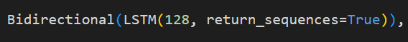
4. | Max Pooling Layer
 | Reduces the sequence length by a factor of pool_size=2. Retains the most salient information within each pooling window.
5. | Bidirectional LSTM Layer
 | Uses 128 LSTM units. Processes the sequence in both forward and backward directions to capture context from both preceding and succeeding words. return_sequences=True indicates that the layer outputs a sequence of outputs for each time step.

Slide 26
6. | Flatten Layer
 | Transforms the 3D output of the Bidirectional LSTM into a 2D tensor, preparing it for the fully connected layers..
7. | Dense Layer
 | A fully connected layer with 128 units and relu activation. Learns complex relationships between the flattened features.
8. | Dropout Layer
 | Applies dropout with a rate of 0.5 (50%) to the units in the preceding Dense layer to prevent overfitting.
9. | Final Dense Layer (Dense)
 | The output layer with 1 unit and sigmoid activation. Suitable for binary classification tasks, outputting a probability between 0 and 1.

Slide 27
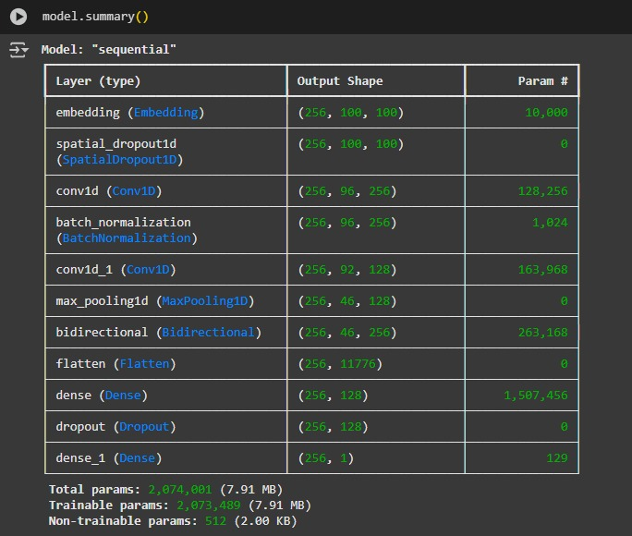
Model Architecture Summary

Slide 28
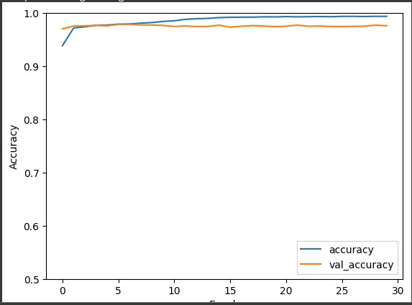
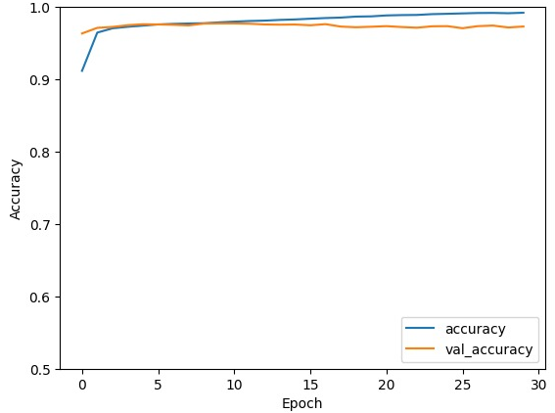
Training Progress and Validation Accuracy:
The CNN-BiLSTM model achieved a validation accuracy of 0.9931.
The CNN model achieved a validation accuracy of 0.9925.

Slide 29
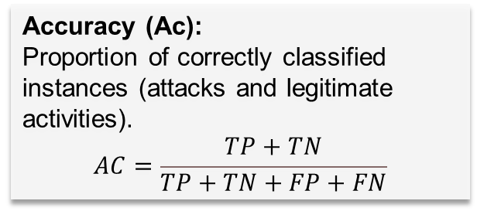
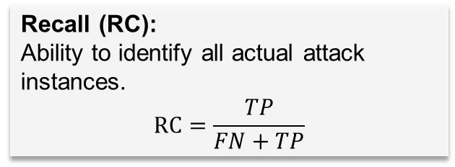
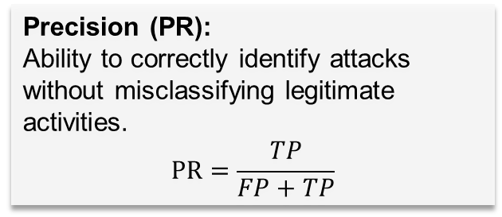
STATICAL ANALYSIS and EVALUATION:
Evaluation Metrics:
The efficacy of our cyber-attack detection model was quantitatively analyzed using standard classification metrics
Accuracy (Ac):
Proportion of correctly classified instances (attacks and legitimate activities).
$$AC=\frac{TP+TN}{TP+TN+FP+FN}$$
Precision (PR):
Ability to correctly identify attacks without misclassifying legitimate activities.
$$PR=\frac{TP}{FP+TP}$$
Loss:
Measures the discrepancy between predicted and actual attack labels. Lower loss indicates better performance.
Recall (RC):
Ability to identify all actual attack instances.
$$RC=\frac{TP}{FN+TP}$$

Slide 30
Comparing Aalgorithms
No. | loss | Accuracy | Precision | Recall
Experiment 1 | 12.3779 | 96.4360 | 98.7025 | 93.7420
Experiment 2 | 5.3113 | 98.8324 | 99.5776 | 97.9629
Experiment 3 | 3.9503 | 99.2994 | 99.7577 | 98.7683
CNN Result
No. | loss | Accuracy | Precision | Recall
Experiment 1 | 5.6540 | 98.8691 | 99.2394 | 98.3785
Experiment 2 | 4.1249 | 99.1363 | 99.5760 | 98.6055
Experiment 3 | 3.6126 | 99.3188 | 99.7470 | 98.8198
CNN-BiLSTM Result

Slide 31
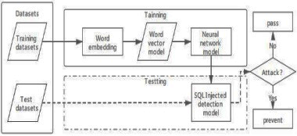
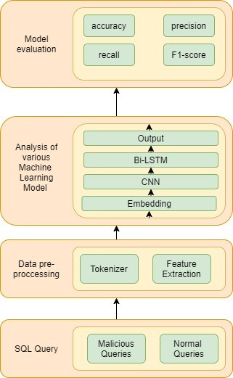
Comparison Between Our Results & Previous Study
Year Of Publish | Result | Tools | Methodology | Propused solution | Problem | Name
2021 | CNN achieved 98.25% accuracy, while MLP achieved 98.57%. | Python, TensorFlow, Keras |  | Detect SQL Injection attacks using deep learning models (CNN and MLP) that automatically learn from SQL query structures. | SQL Injection attacks are a critical security risk, allowing unauthorized access to databases and manipulation of sensitive information. | SQL Injection Attack Detection and Prevention Techniques Using Deep Learning
CNN Model Result | 3.9503 | 99.2994 | 99.7577 | 98.7683
Year Of Publish | Result | Tools | Methodology | Propused solution | Problem | Name
2021 | CNN-BiLSTM achieved 98% accuracy, outperforming Naive Bayes, Logistic Regression, and SVM. | Python and TensorFlow |  | Detect SQL injection attacks using a CNN-BiLSTM hybrid model and compare it against other algorithms. | SQL Injection is a significant security vulnerability that allows attackers to manipulate databases and gain unauthorized access to critical data. | A CNN-BiLstm Based Approach for Detection of SQL Injection Attacks
CNN-BiLstm Model Result | 3.6126 | 99.3188 | 99.7470 | 98.8198

Slide 32
Conclusion & Recommendations
Conclusion
CNN-BiLSTM outperformed standalone CNN in SQL injection attack detection
Future Work
Enhance cyber-attack detection by integrating attention into the CNN-BiLSTM model. Improve resilience against adversarial attacks. Deploy and evaluate the system in real-world e-business settings.
Adopt the CNN-BiLSTM model as a key component of digital platform cybersecurity. Invest in training personnel for implementation and understanding of these technologies. Regularly update security systems with the latest threat detection advancements.
Recommendation
CNN-BiLSTM: 99.31% validation accuracy vs. 99.29% for CNN
Integrating CNN and BiLSTM was crucial for superior performance

Slide 33
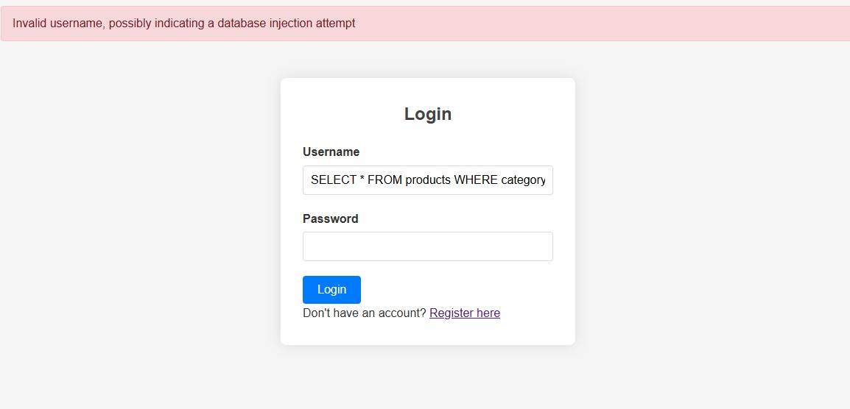
Testing …

Slide 34
THANK
YOU
Datasets : https://www.kaggle.com/datasets/ayahkhaldi/sql-injection-dataset
Google Colab : https://colab.research.google.com

